Slide 1

DSO510 Project 2
Group Members:
Cheng CHEN, Cheng ZHANG, Jie CHEN, Mi ZHONG,
Xinyu LIANG, Yang LU, Yinghan LIU

Slide 2
Goal Definition
Analyze the relationship between gross box office of a movie and other independent variables including genre, budget, popularity of director and cast, etc., in order to:
guide film producers/investors on how to make high-quality movies, and
help movie theaters predict which movies will generate higher box office

Slide 3
Data Collection
The dataset named “IMDB 5000 Movie Dataset” is downloaded from Kaggle, and it contains 28 variables for 5,043 movies
This project focuses on 10 variables (see next page)
Observations with missing values for gross box office are excluded from analysis; only movies produced after 2000 are included
A total number of 3,070 observations meet the criteria above

Slide 4





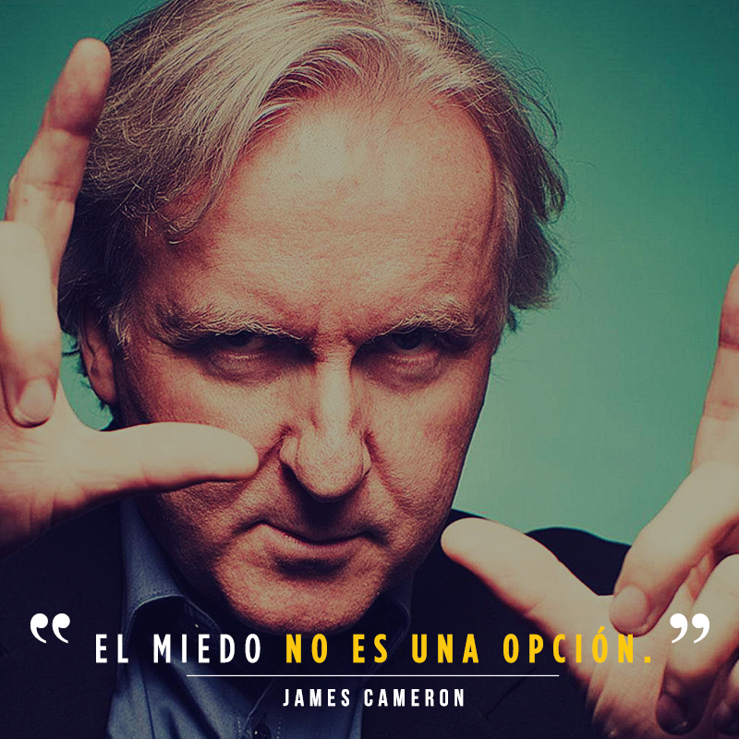
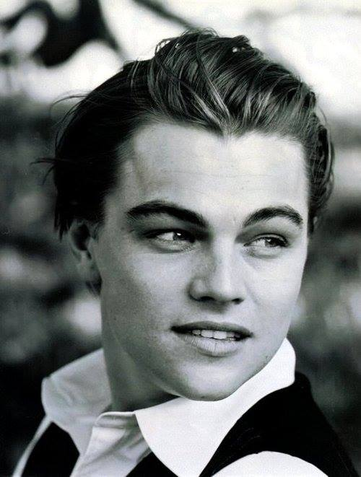

Slide 5
Data Collection
Variables | Type | Explanation
Gross (dependent variable) | Numeric | Cumulative box office in United States
IMDB Score (dependent variable) | Numeric | IMDB rating score of the movie
Duration | Numeric | Length of the movie
Genre | Categorical | Genre of the movie (Action/Sci-Fi/Romance/...)
Country | Categorical | Country that produced the movie
Budget | Numeric | Budget of the movie (in USD)
Content Rating | Categorical | Content rating of the movie (G/PG/PG-13/R/…)
Director Facebook Likes | Numeric | Facebook popularity of the director
Cast Total Facebook Likes | Numeric | Facebook popularity of all cast members
Number of Critics for Reviews | Numeric | Number of critics that reviewed the movie

Slide 6
Interpretation, Action, and Feedback
Describe interpretation of the data analysis and modeling in the context of the business goal
Use Excel, SAS, Tableau to dig further into the relationship between gross box office/IMDB score and all the selected independent variables
Find the most relevant variables for producers/investors to make quality/revenue-related decisions
Analyze the best combinations of directors, film genres, actors, budget, etc. for producers to proceed a best-selling movie
Notes:
relationship (positive/ negative correlation, trend, etc.)

Slide 7
Interpretation, Action, and Feedback
Possible options and/or decisions available to the business based on the data analysis and modeling
For film producers/movie theaters, in order to produce/select a movie having high box office potential, it is recommended that they:
choose director and actors with higher Facebook likes/search interest
make movies in...genre/with...duration/etc. that attracts more audiences
consider the marginal effect of …(independent variable) on box office

Slide 8
Variables
Dependent Variable
Gross (A movie's total box-office in United States)
IMDB score,
Independent Variables (10)
Numeric: Number of Critics for reviews, Duration, Cast total Facebook-likes, Content rating, Budget, Director Facebook-likes.
Categorical: Genres, Country, Title year

Slide 9
Variables
Numeric Variables
Dependent:
Gross , IMDB score,
Independent:
Number of Critics for reviews, Duration, Cast totoal Facebook-likes,
Budget, Director Facebook-likes
Category Variables
Independent:
Genres, Country, Content rating, Title year

